Slide 1
PISA 2018: Exploratory Data Analysis
Greece's Position & Gender Gap Analysis

Slide 2
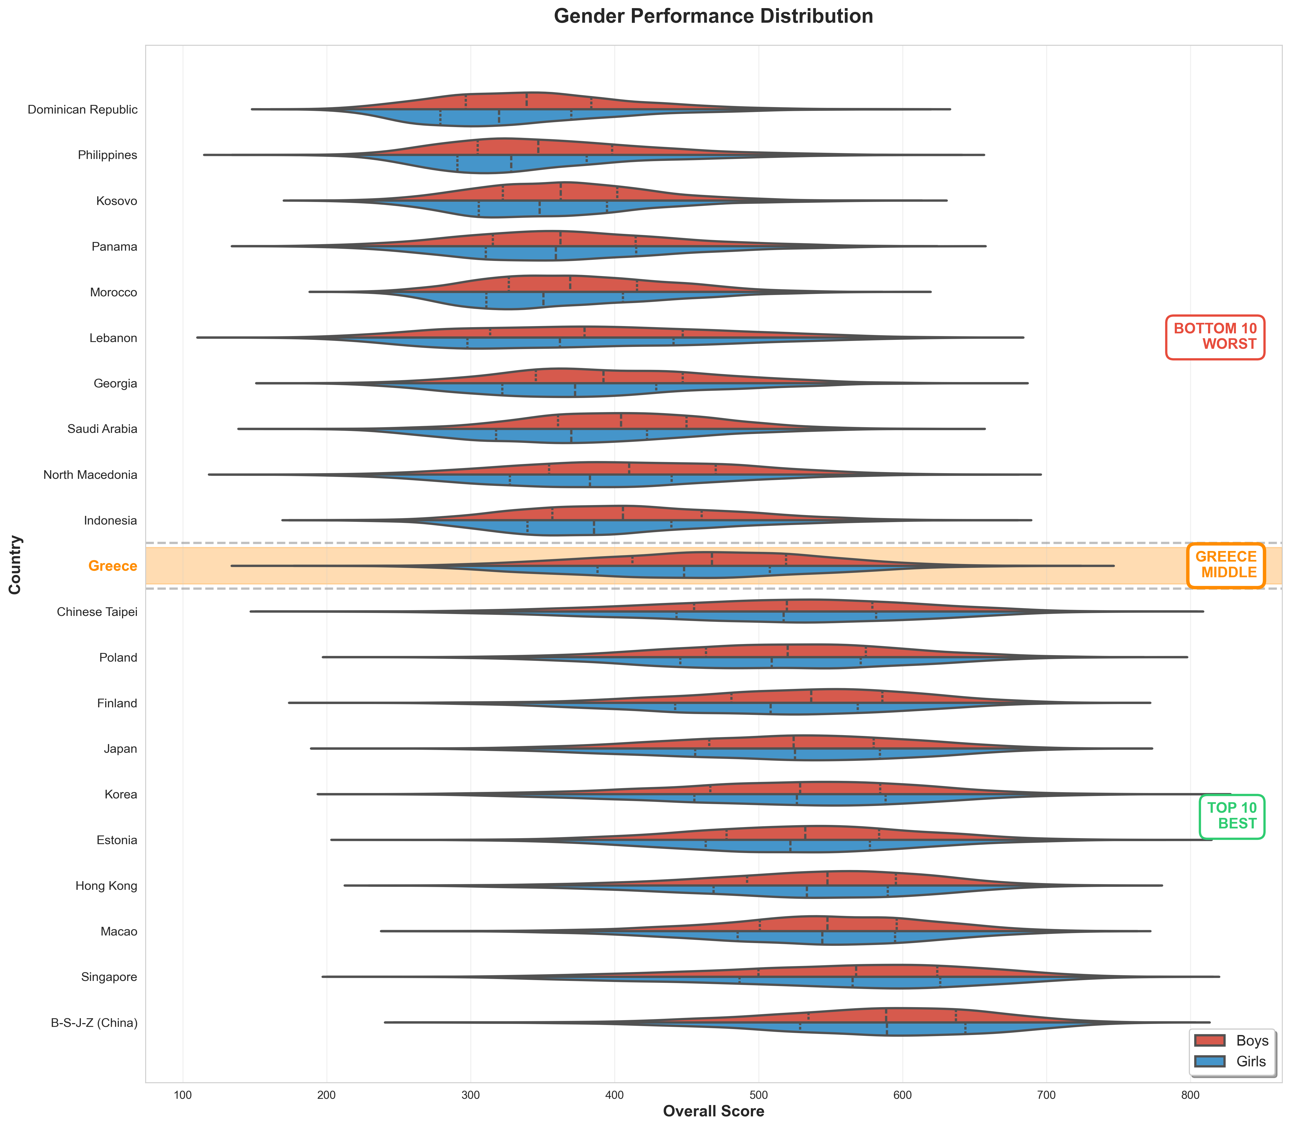
1. Gender Performance Distribution
Horizontal violin plots showing score distributions for boys (blue) and girls (red) across Top 10, Greece,
and Bottom 10 countries. Greece highlighted in orange.

Slide 3
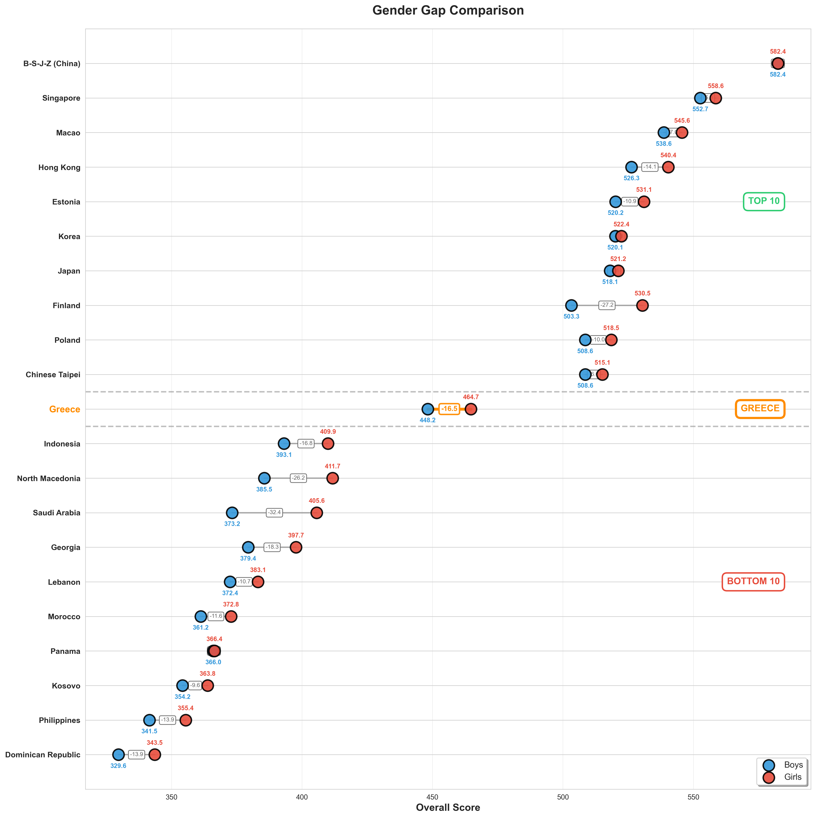
2. Gender Gap Comparison
Dumbbell chart comparing boys (blue) vs girls (red) scores. Lines show the gap between genders, with gap values
displayed. Smart positioning avoids label overlap.

Slide 4
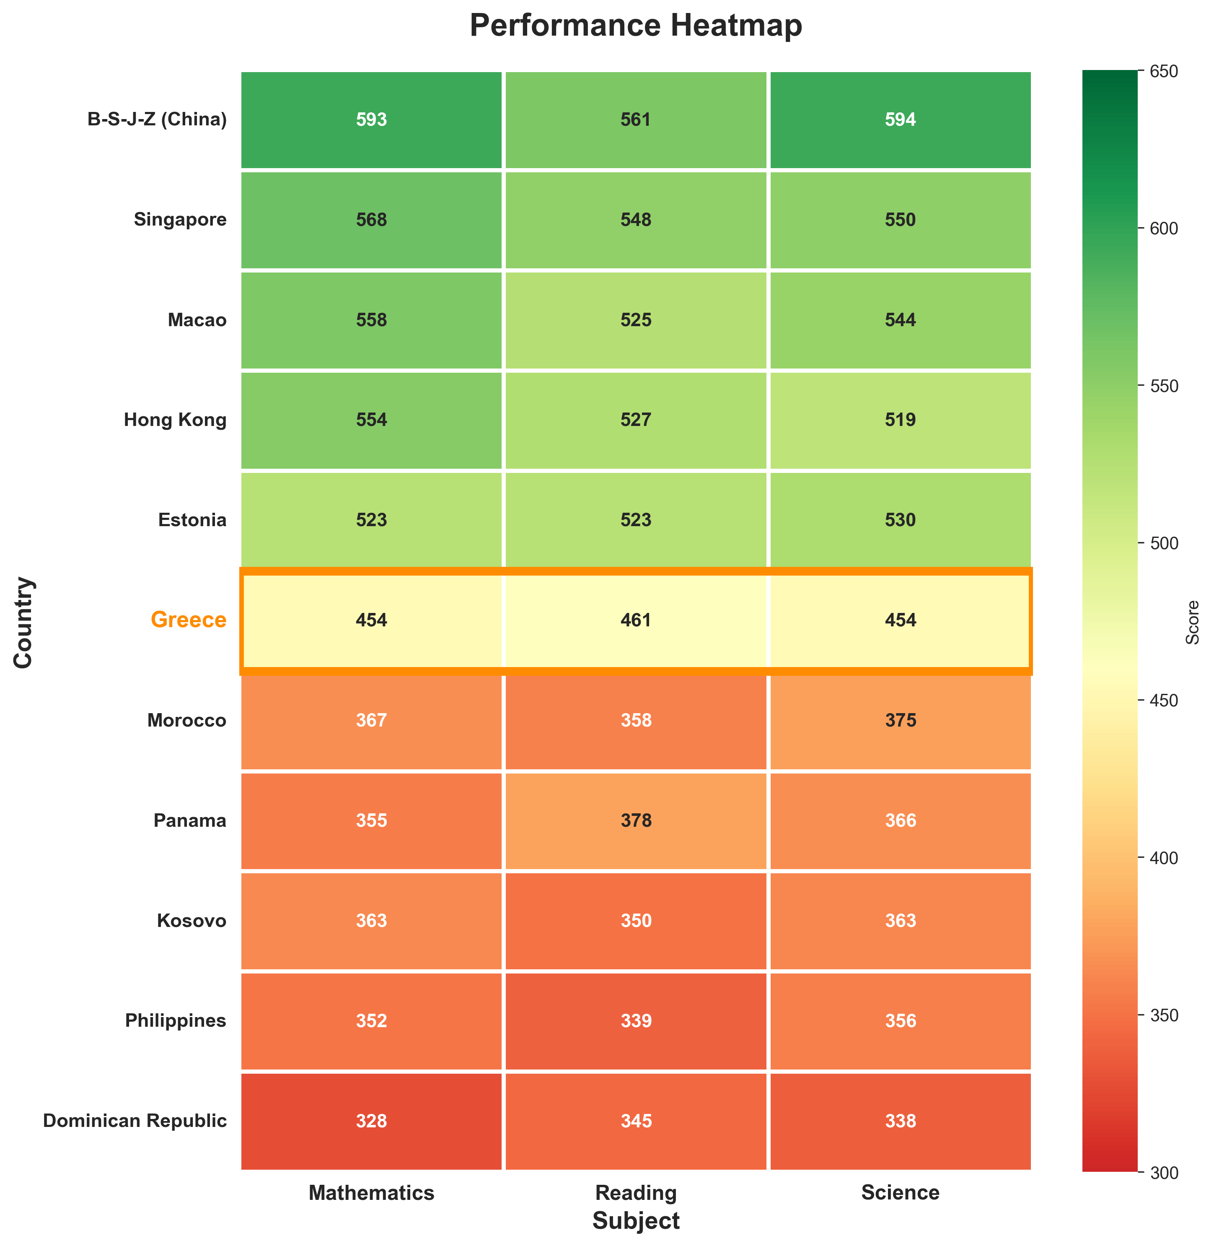
3. Performance Heatmap
Heatmap showing Math, Reading, and Science scores for Top 5, Greece, and Bottom 5 countries. Color intensity
indicates performance level (green = high, red = low).

Slide 5
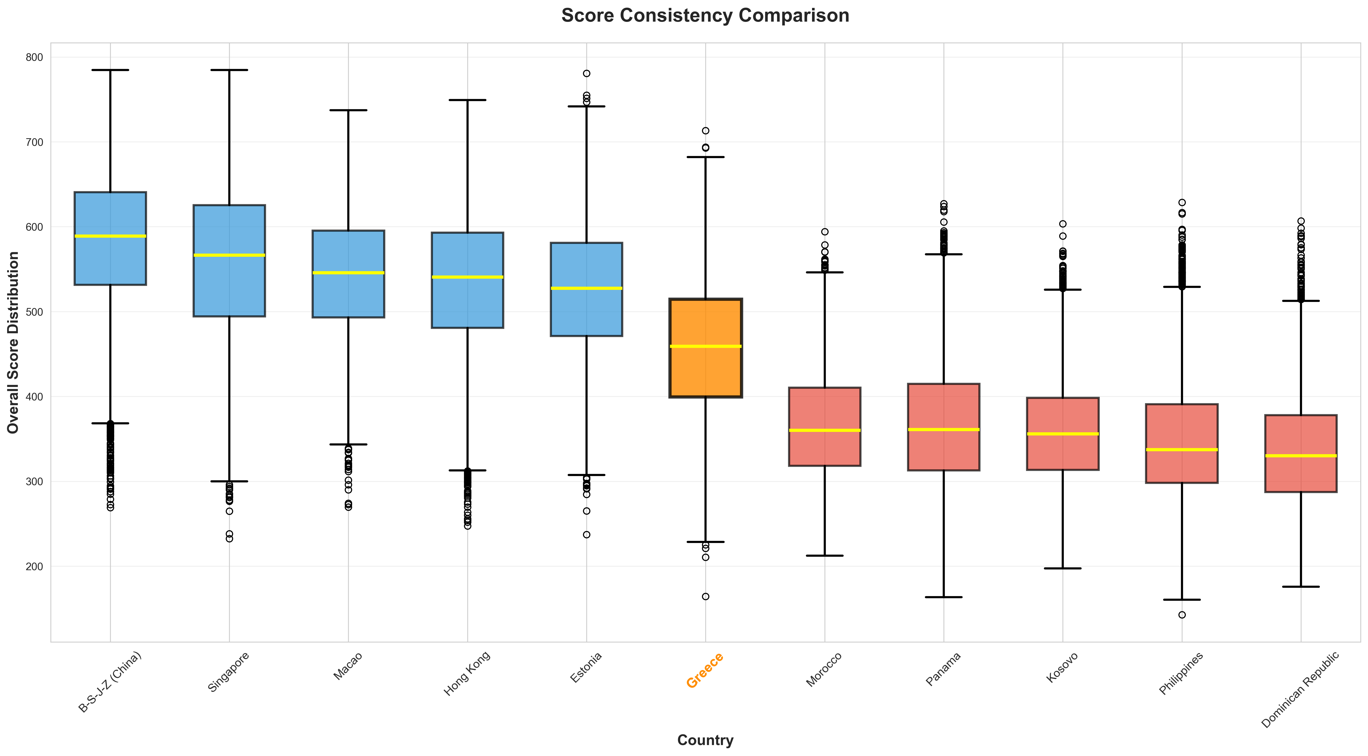
4. Score Consistency Comparison
Box plots showing score variability and distribution for selected countries. Greece (orange) compared to Top 5 (blue)
and Bottom 5 (red) performers.

Slide 6
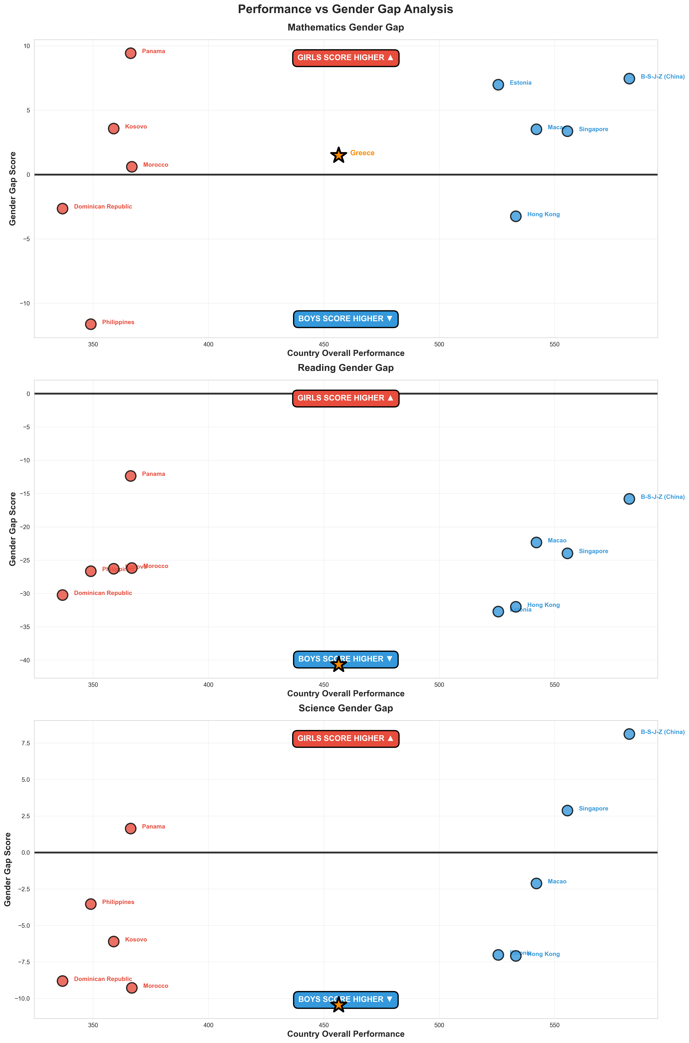
5. Performance vs Gender Gap Analysis
Three scatter plots (Math, Reading, Science) showing relationship between country performance and gender gaps.
Greece marked with orange star. No correlation found!

Slide 7
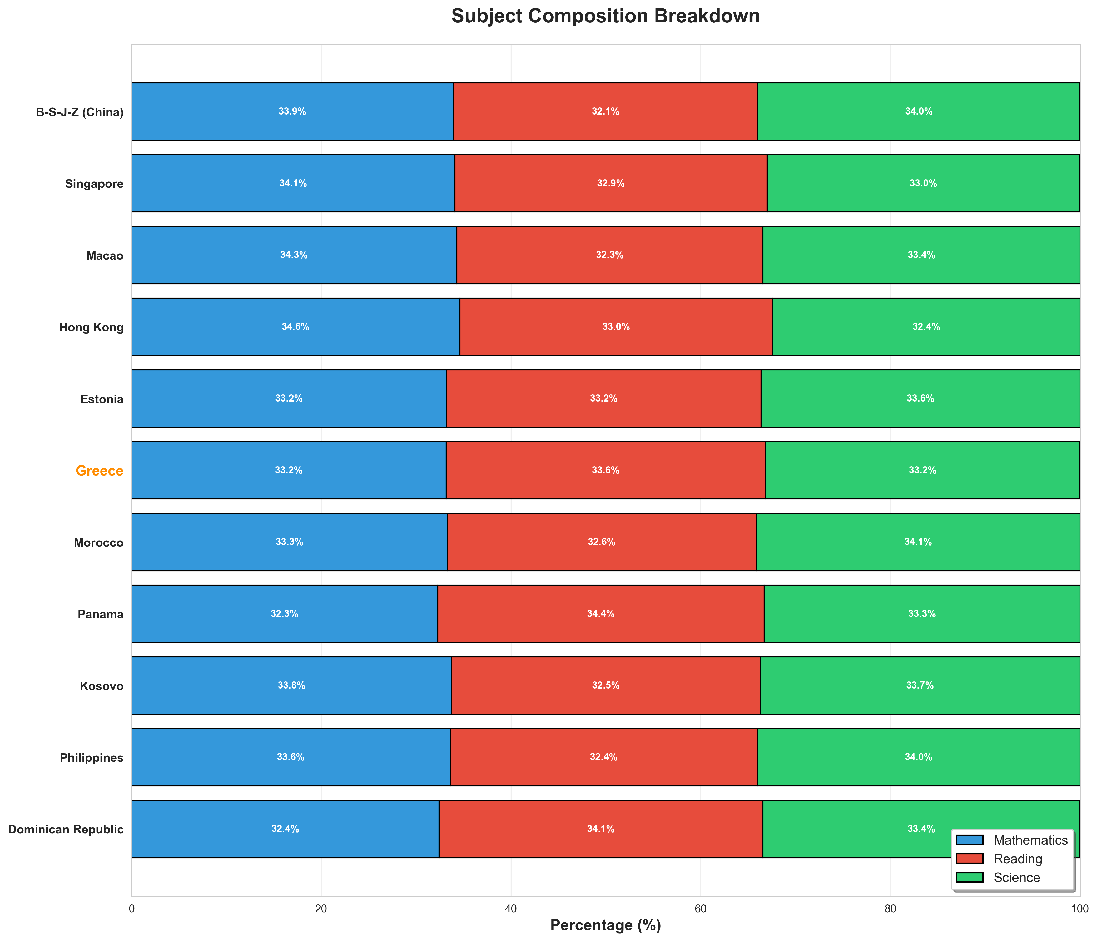
6. Subject Composition Breakdown
Stacked bar chart showing percentage contribution of each subject (Math, Reading, Science) to overall scores.
Reveals balanced performance across subjects.

Slide 8
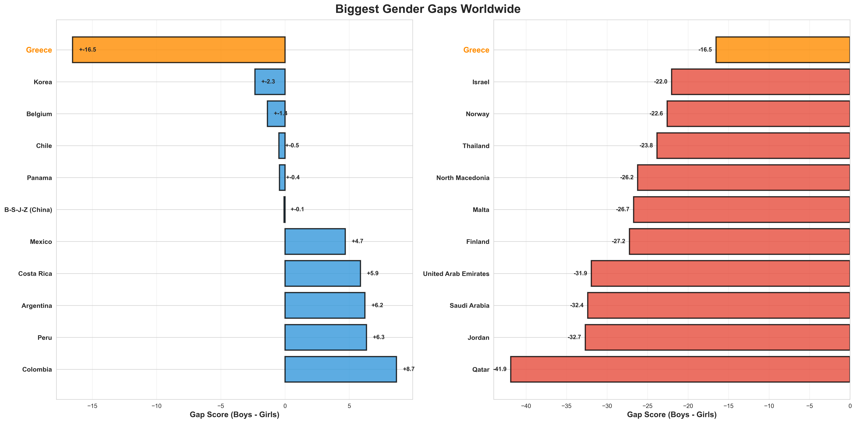
7. Biggest Gender Gaps Worldwide
Two panels showing countries with largest gaps: Boys ahead (blue) and Girls ahead (red). Greece included for
comparison, showing moderate gap favoring girls.

Slide 9
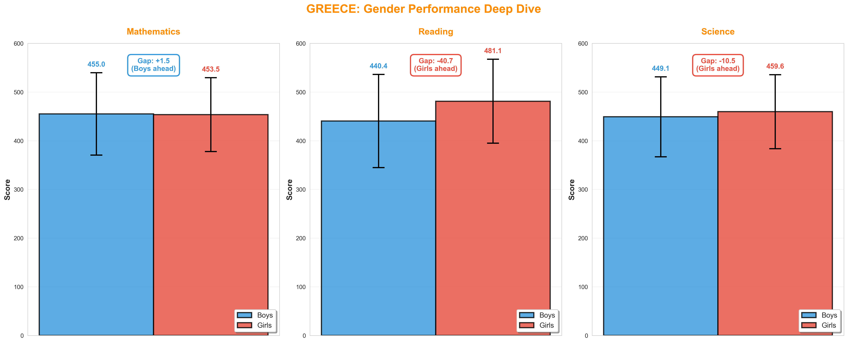
8. Greece: Gender Performance Deep Dive
Detailed breakdown of Greece's gender performance by subject with error bars (standard deviation). Boys slightly
ahead in Math, girls dominate in Reading and Science.

Slide 10
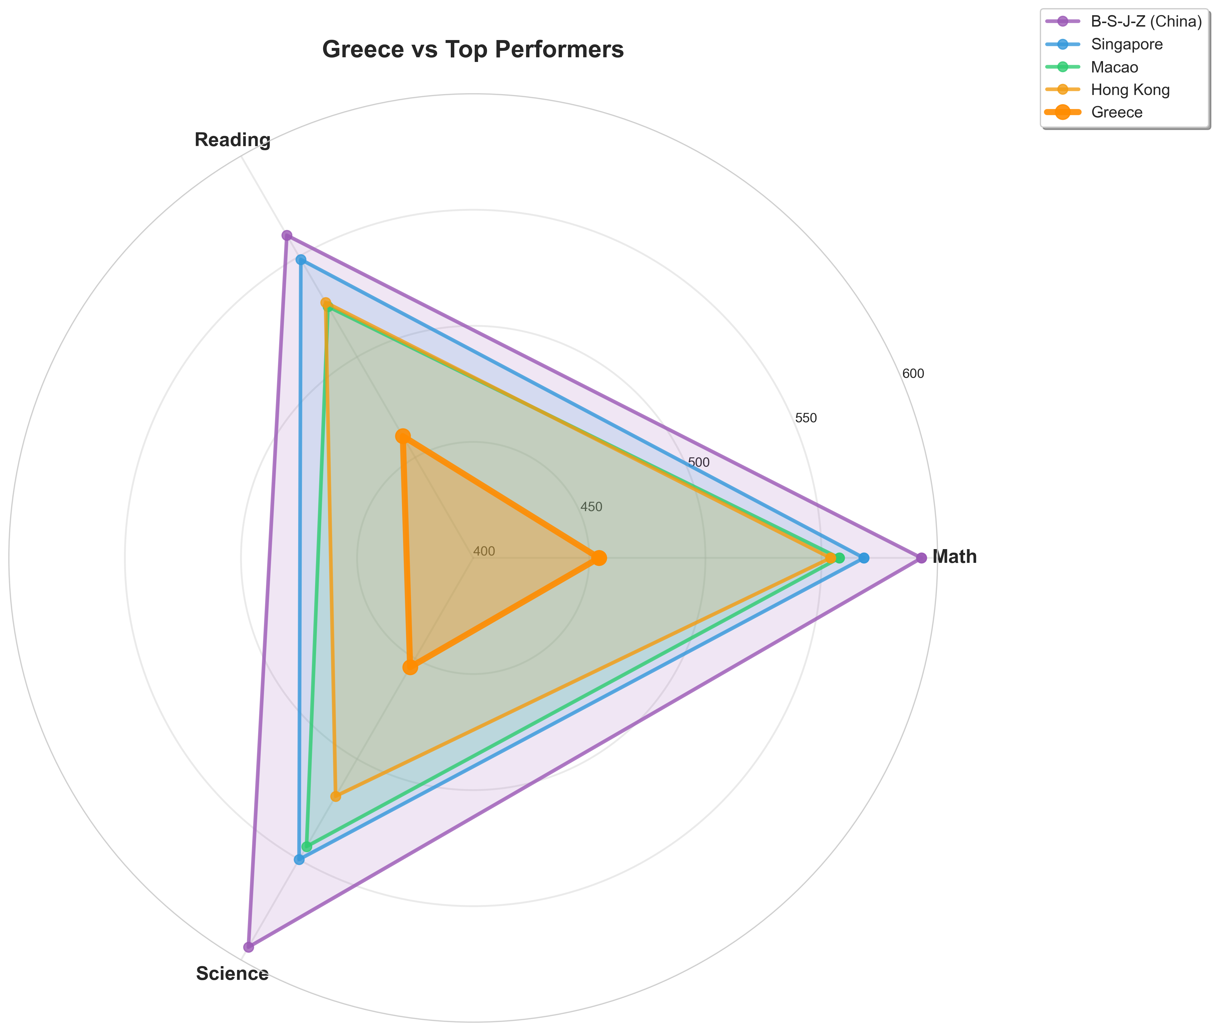
9. Greece vs Top Performers
Radar chart comparing Greece (thick orange line) to the world's top 4 performers across all three subjects.
Shows Greece's gap with leading nations.

Slide 11
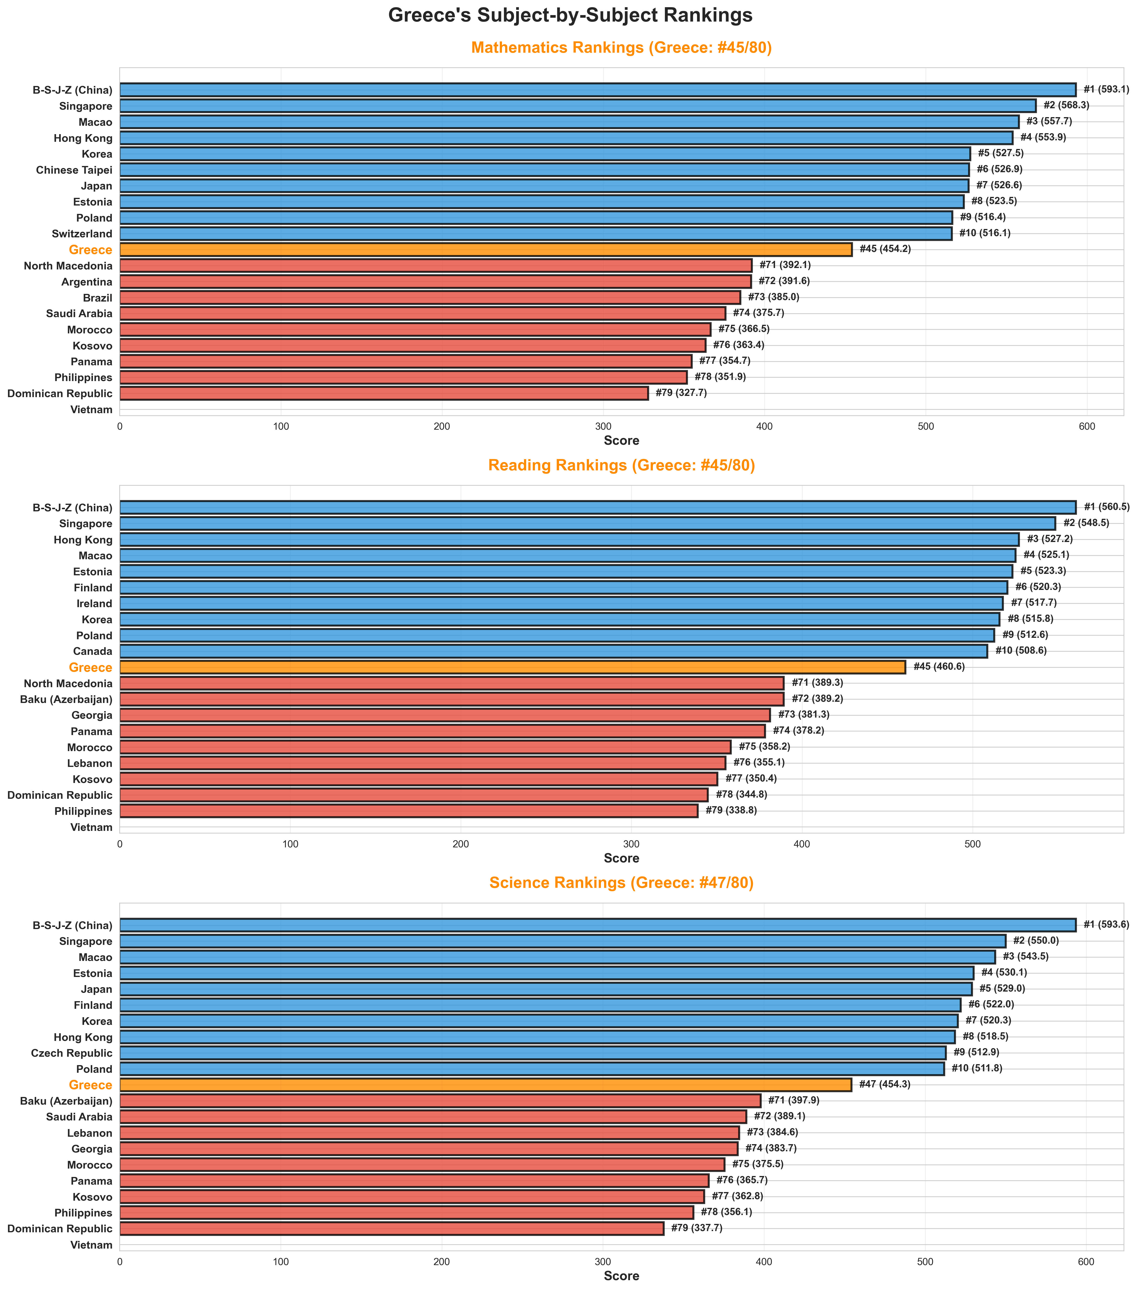
10. Greece's Subject-by-Subject Rankings
Three horizontal bar charts showing Greece's ranking (orange) compared to Top 10 and Bottom 10 in each subject.
Consistent mid-tier performance across all subjects.

Slide 12
Key Findings
Greece's Position: Rank 46/80 countries (Middle tier)
• Overall Score: 456.39 points
• Consistent across subjects (Math: 45th, Reading: 45th, Science: 47th)
Gender Gaps in Greece:
• Math: Nearly equal (Boys +1.5 points)
• Reading: Girls dominate (Girls +40.7 points)
• Science: Girls ahead (Girls +10.5 points)
Global Pattern:
• No correlation between country performance and gender gaps
• High performers can have large OR small gaps

